Slide 1
ME 203 – Introduction to Computer Methods for Engineers Fall 2021

Slide 2


Article - Students: How to Install Of...
https://www.mathworks.com/academia/tah-portal/university-of-nevada-reno-40773250.html

Slide 3

Introduction to MS Excel

Slide 4
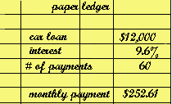
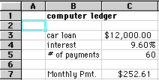
Excel as a Spreadsheet
Definition:
A spreadsheet is a computer program that organizes data into rows and columns, for computing desired calculations and making overall adjustments based on new data.
The advantage of using a spreadsheet is that it is easy to go back and and change numbers without having to recalculate everything.

Slide 5
Why Use Excel?
The value of Microsoft Excel lies in its ability to manipulate numbers easily. This makes Excel useful for budgets and other things which require mathematics.
Formulas can be created once and copied rather than needing to re-create the formula each time.
Excel is a useful tool when preparing graphs detailing the results of your calculations.
Information can be saved and imported into other programs such as Microsoft Word.

Slide 6
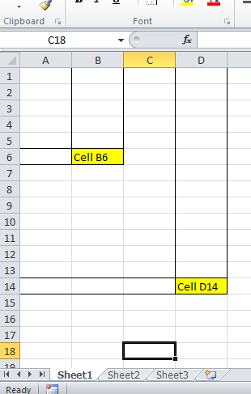
Overview of the Excel Screen
Microsoft Excel consists of workbooks. Within each workbook, there is an infinite number of worksheets.
Each worksheet contains columns and rows.
Where a column and a row intersect is called the cell. For example, cell B6 is located where column B and row 6 meet. You enter your data into the cells on the worksheet.
The tabs at the bottom of the screen represent different worksheets within a workbook. You can use the scrolling buttons on the left to bring other worksheets into view.

Slide 7
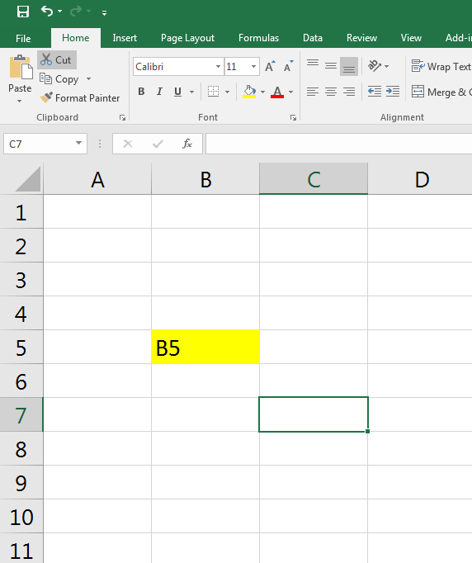
Overview of the Excel Screen
The Name Box indicates what cell you are in. This cell is called the “active cell.” This cell is highlighted by a black box.
The “fx” is used to edit your formula on your selected cell.
The Formula Bar indicates the contents of the cell selected. If you have created a formula, then the formula will appear in this space.

Slide 8
Excel Worksheets
With Excel, you will be working with different worksheets within a workbook. Often times it is necessary to name the different worksheets so that it is easier to find them. To do so you must:
1) Double click to highlight an existing worksheet
2) Type in what you would like to rename the worksheet

Slide 9
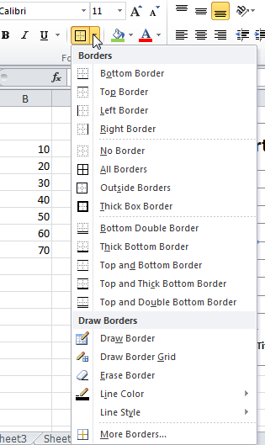
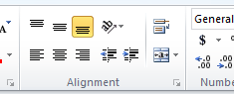
Formatting Workbooks
To add borders to cells, you can select from various border options.
To add colors to text or cells, you can select the text color option or the cell fill option, then select the desired color.
To change the alignment of the cells, highlight the desired cells and select any of the three alignment options.

Slide 10
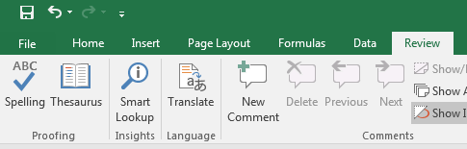


Formatting Workbooks
To check the spelling of your data, highlight the desired cells and click on the spelling button under the Review tab.
When entering dollar amounts, you can select the cells you desire to be currency formatted, then click on the “$” button to change the cells.
You can bold, italicize, or underline any information in the cells, as well as change the styles and fonts of those cells.

Slide 11
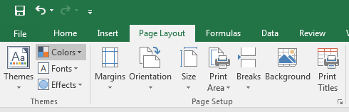
Printing
When printing a worksheet you have a few options.
You can go to “Page Setup” under the Page Layout tab to change the features of your work (the margins, the paper size, the tabs, etc.) This will affect how your project will be printed.
You can select “Print Area,” which allows you to only print a highlighted area.

Slide 12
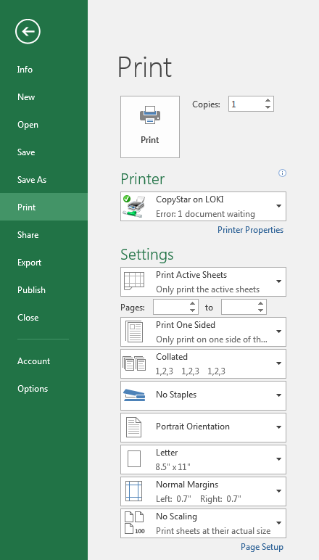
Printing
File Tab
You can preview your printing job before printing
Finally, you can print your job by going to the Office Button and selecting “Print.”
Can also Save As PDF file to create PDF files directly

Slide 13
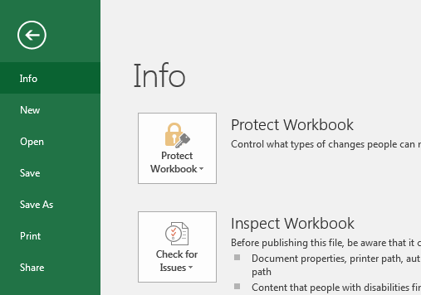
Saving
You must save all homework for this class as an Excel workbook
Click on the File Button
Go to Save As
Select Excel workbook

Slide 14
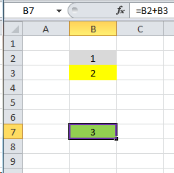
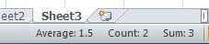
Entering Formulas
When entering numerical data, you can command Excel to do any mathematical function.
Start each formula with an equal sign (=). To enter the same formulas for a range of cells, use the colon sign “:”
ADDITION FORMULAS
To add cells together use the “+” sign.
To sum up a series of cells, select the cells. The answer will appear at the bottom of the worksheet.

Slide 15
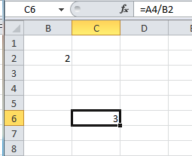
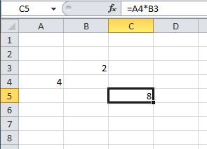
Entering Formulas
SUBTRACTION FORMULAS
To subtract cells, use the “-” sign.
DIVISION FORMULAS
To divide cells, use the “/” sign.
MULTIPLICATION FORMULAS
To multiply cells, use the “*” sign.

Slide 16
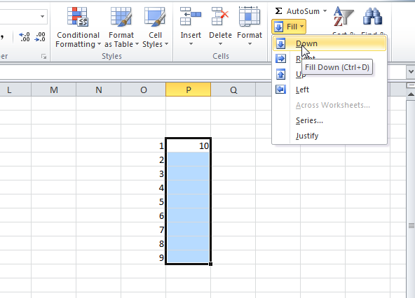
Fill Down & Fill Right
“Fill” is quick way of copying and pasting

Slide 17
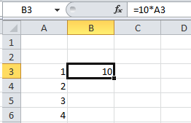
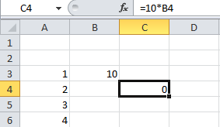
Relative vs. Absolute Referencing
By default, cell references are relative
“$” in formula “locks” the row or column (i.e. makes the cell reference absolute)
$A10 (the column will not change when copy/pasting)
A$10 (the row will not change when copy/pasting)
$A$10 (neither row nor column change)
Copy & Paste

Slide 18
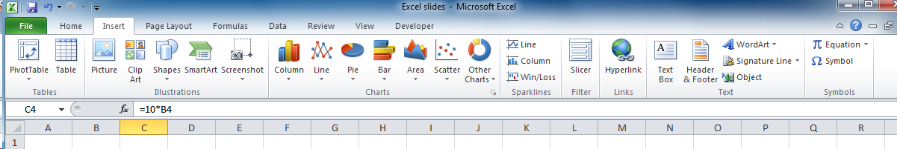
Charts or Graphs
Numbers can usually be represented quicker and to a larger audience in a picture format. Excel has a chart program built into its main program. The Chart Wizard will step you through questions that will (basically) draw the chart from the data that you will select. There are many types of charts.
Click on the Insert Menu and you will get the charts menu

Slide 19
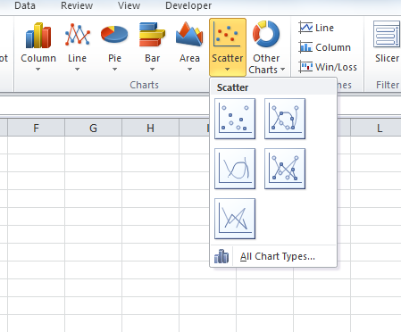
Creating Charts
With the Excel program you can create charts clicking on Insert
Step 1:Highlight the data that you wish to be included in the chart.
Step 2: Choose a chart type to insert.

Slide 20
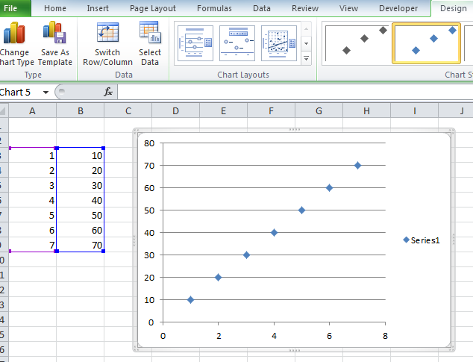
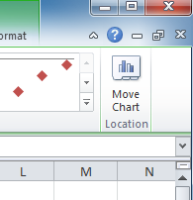
Creating Charts
Step 3: Choose a chart layout. Then double click on the title and axis labels to change them.
Step 4: Choose a location for the chart.

Slide 21
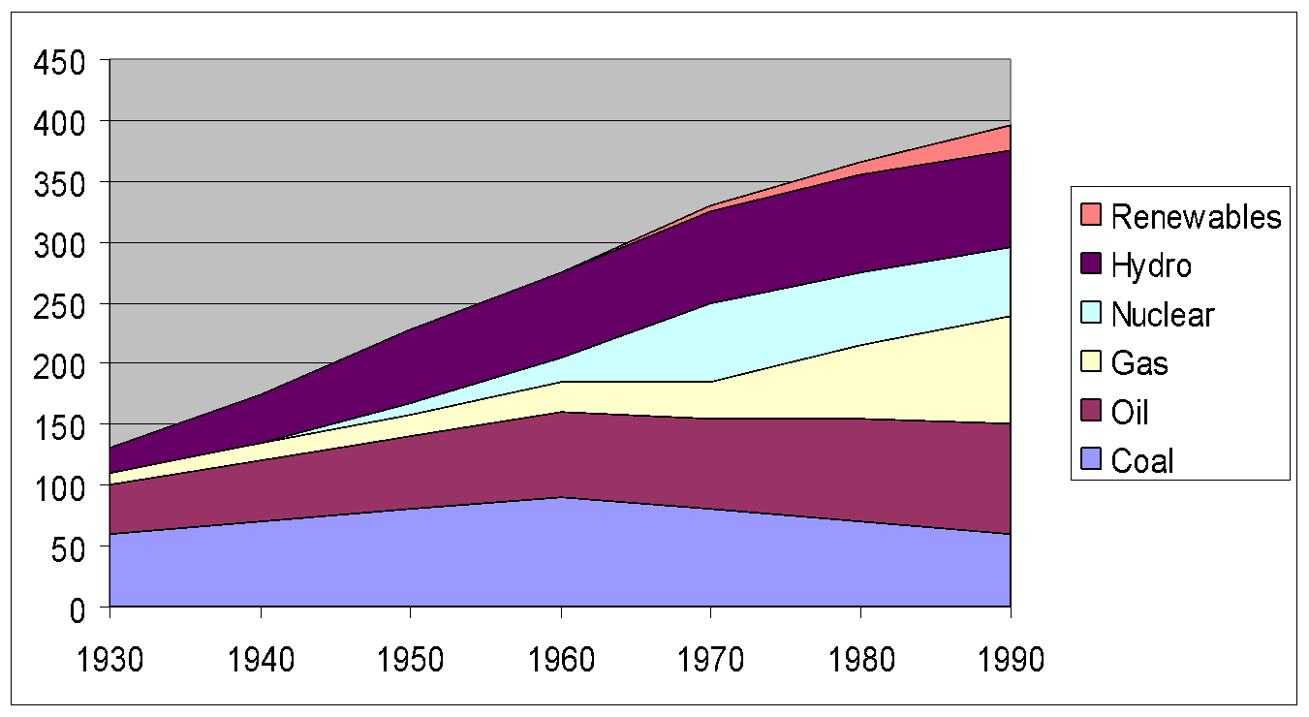
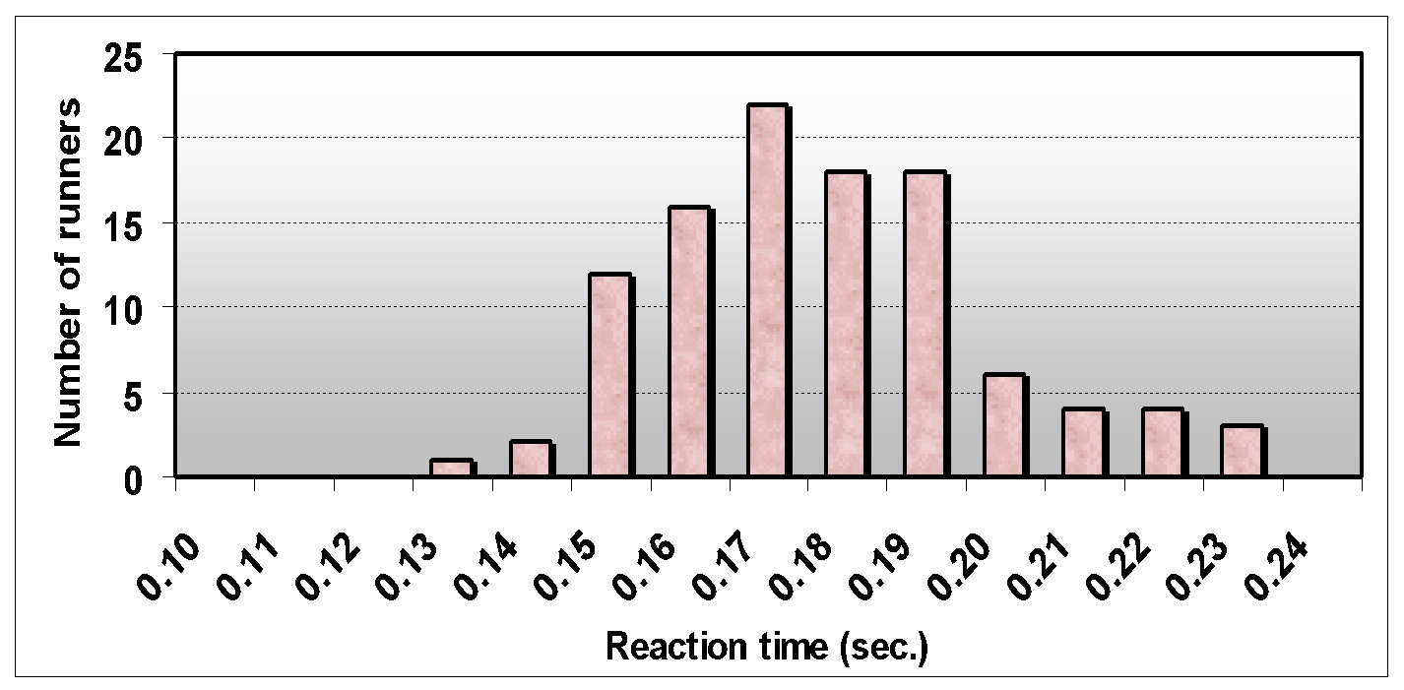
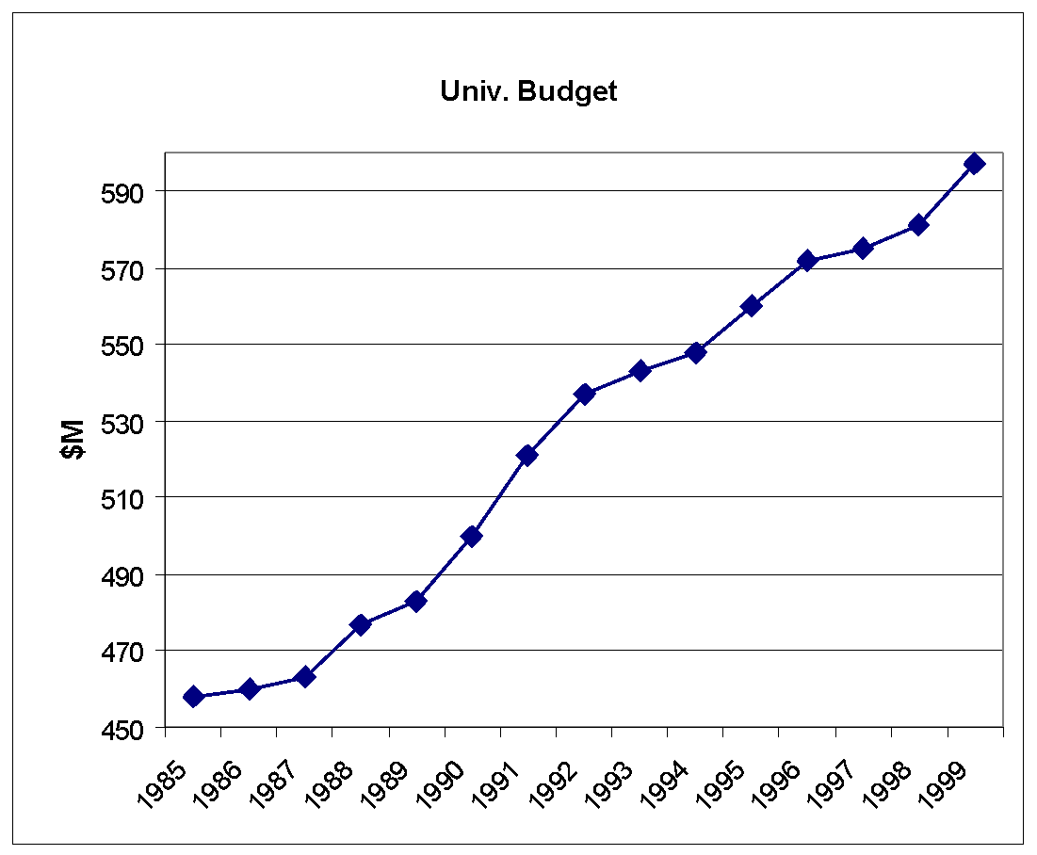
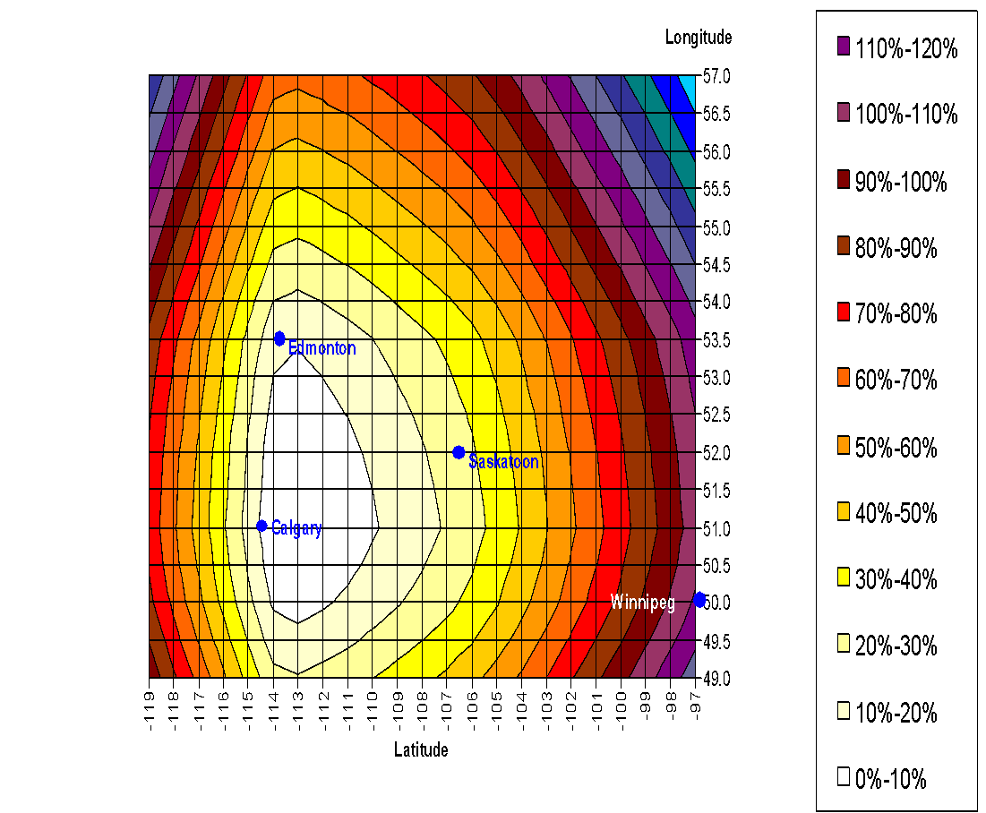
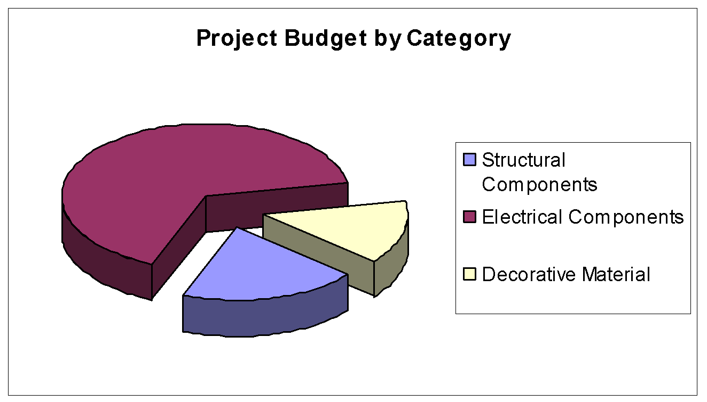

Slide 22
Example
A small object is launched into flight from the ground at a speed of 50 miles/hour at 30 degrees above the horizontal over level ground. Determine the time of flight and the distance traveled when the ball returns to the ground.

Slide 23
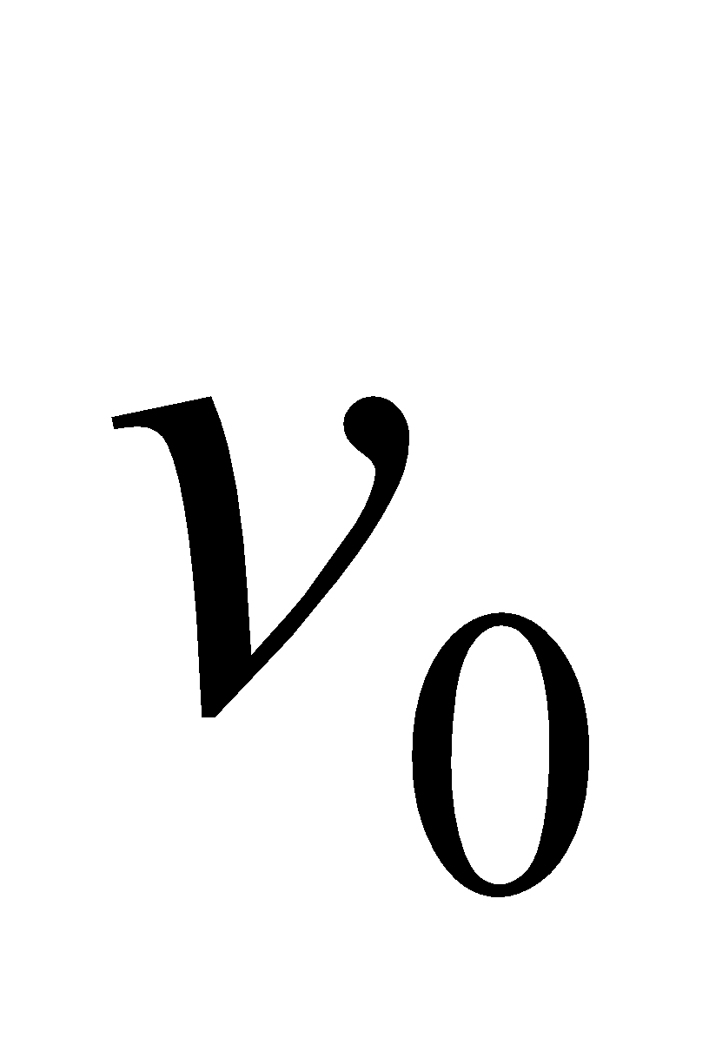

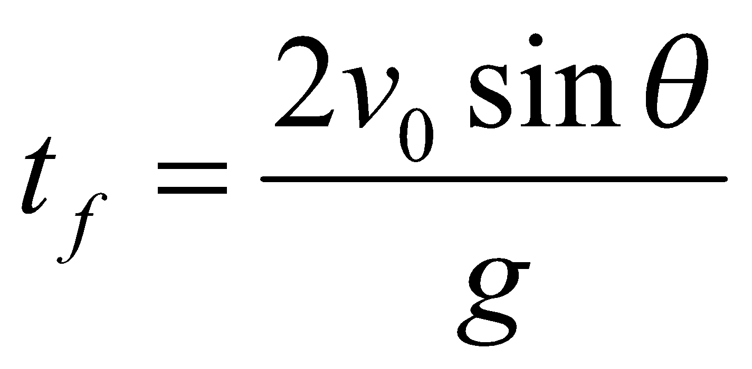
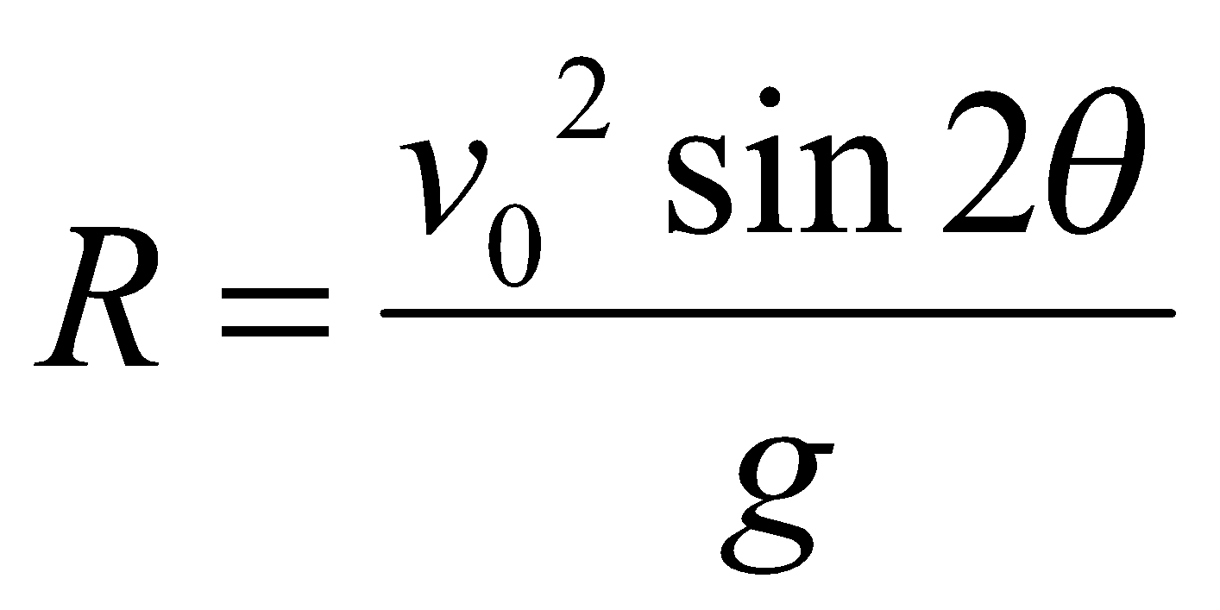
Example…
Initial velocity
Initial launch angle
Time of flight
Horizontal range

Slide 24
Example…
Define known values
Initial Values
v | 50 | mph
theta | 30 | degrees
g | 32.2 | ft^2/s
Convert Units
Convert Units
v | 73.33333 | ft/s
theta | 0.523599 | rad
Calculate Results
tf | 2.277433 | s
R | 144.6364 | ft
Calculate Results

Slide 25
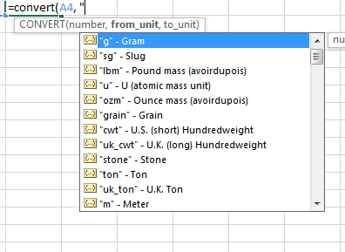
Convert Function for Units
Convert units in Excel
=convert(value, from_units, to_units)
You can only use the abbreviations in excel’s list
You cannot combine units such as gal/mn (gallons per minute)

Slide 26
Trendline
A trendline fits a line to a set of data points
The mathematical term for a trendline is a regression line
You will learn more about them if you take Linear Algebra
You will also learn about them in Applied Numerical Methods

Slide 27
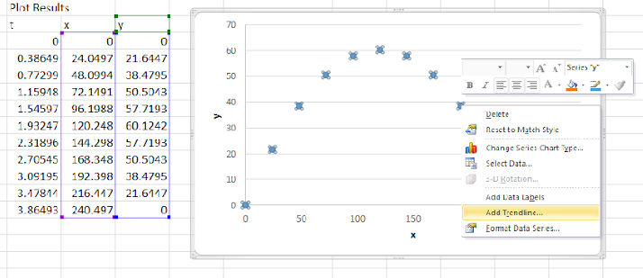
Adding a Trendline

Slide 28
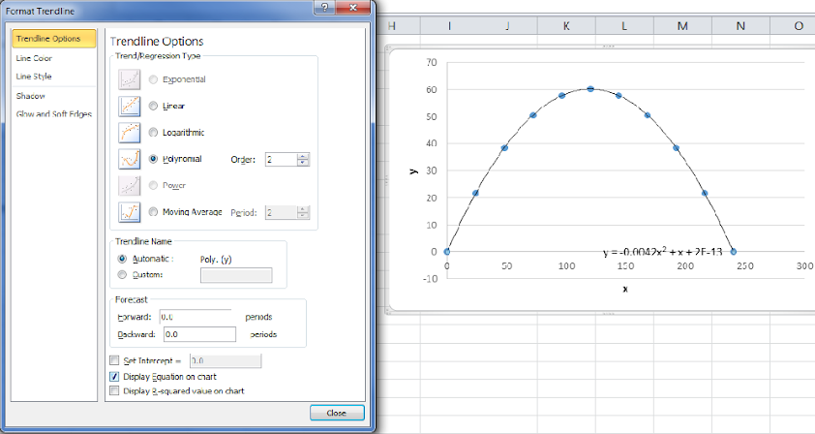
Formatting a Trend line

